Slide 1
Secure Data Hiding in Images using Steganography
CAPSTONE PROJECT
Presented By: Mangalam Srivastava
Student Name : Mangalam Srivastava
College Name & Department : Babasaheb Bhimrao Ambedkar University , Computer Science

Slide 2
OUTLINE
Problem Statement
Technology used
Wow factor
End users
Result
Conclusion
Git-hub Link
Future scope

Slide 3
Problem Statement
Traditional encryption makes secret communication suspicious, whereas steganography hides data inside images to keep it undetectable.
Existing methods lack strong encryption, making hidden data vulnerable to attacks.
Ensuring high capacity while maintaining image quality is a challenge.Hidden data should remain intact even after image compression or minor modifications.
The method should be resistant to modern steganalysis techniques to avoid detection.
A secure approach using LSB encoding, encryption, and password protection is needed for safe data hiding and retrieval.

Slide 4
Technology used
Hardware requirements –
A Laptop or A Computer
Intel i3 or Amd Ryzen 3 Processor
Minimum – 4 Gb Ram
Software requirements –
Accessible Operating System – Windows , Linux
Code Editor – VS code , Python Idle, Pycharm , Anaconda
Libraries – open Cv , hashlib
Code verification Software – Open Stego
Source available - Github

Slide 5
Wow factors
Steganography offers us an Seure way to Protect our Data .
It Also offers an way of Representation to be Aware for malwares , Phishing Scams .
It gives an Secure Channel to Communicate our Sensitive data.
It gives us a Privacy Space to hide our Credientials , any type of information we want to hide from someone.
The Decryption helps us to get information about someone intented of doing something suspicious or wrong.
It helps agencies or nation wider to transport data harm for the country

Slide 6
End users
Students Journalists & Activists – To securely share sensitive information without detection.
Government & Defense Agencies – For confidential communication and secure intelligence exchange.
Corporate Sector – To protect trade secrets and sensitive business data.
Cybersecurity Professionals – For secure information transfer and forensic applications.
General Users – To privately share personal data without raising suspicion.
Researchers & Developers – For exploring advanced steganographic techniques and security improvements.
Armed forces , Agents , Hackers

Slide 7
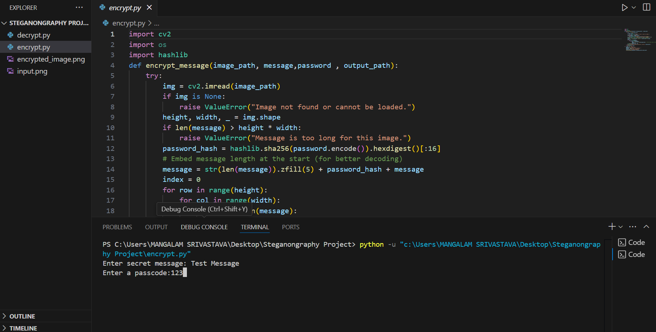
Results

Slide 8
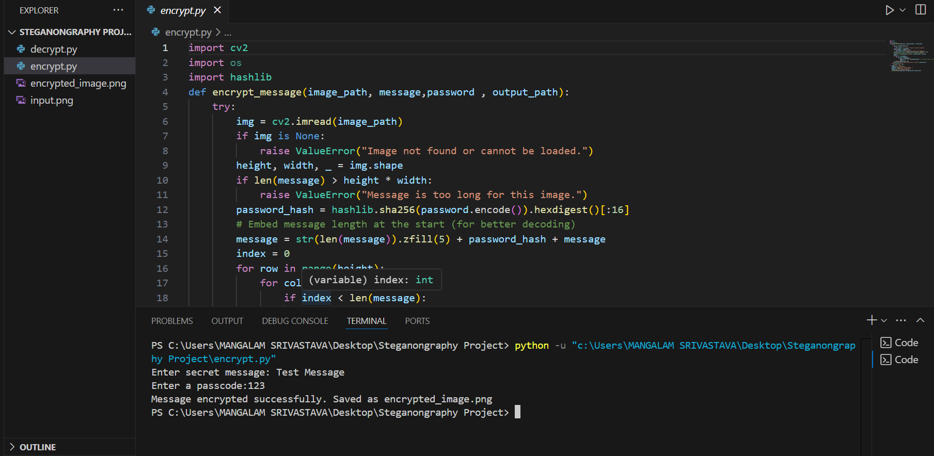




Slide 9
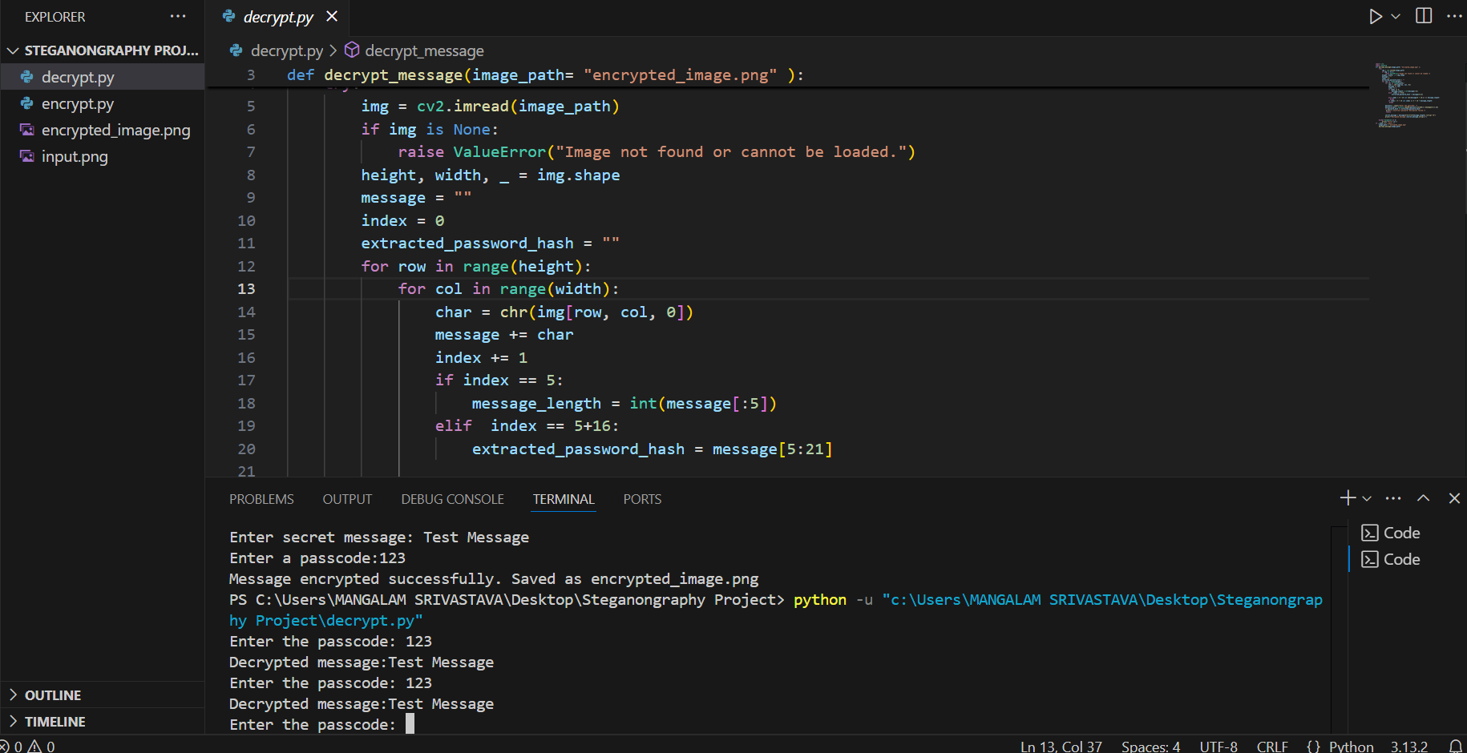

Slide 10
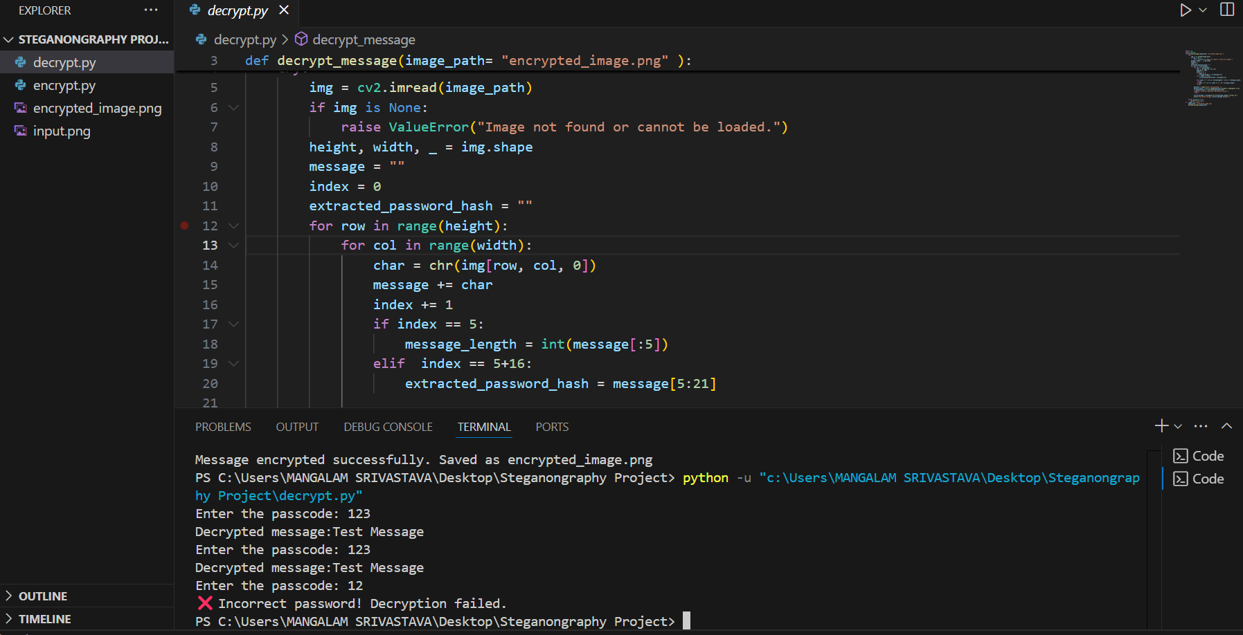



Slide 11
Conclusion
Steganography provides a discreet method for secure data transmission by embedding information within images.
Implementing encryption and password protection enhances security, preventing unauthorized access.
The Least Significant Bit (LSB) technique ensures efficient data hiding with minimal visual distortion.
A well-designed system can withstand image compression and modifications, ensuring robustness.
This method reduces the risk of detection by modern steganalysis tools, making communication safer.
Overall, combining steganography with encryption creates a more secure and reliable approach for confidential data sharing

Slide 12
GitHub Link
Github Link
https://github.com/CRYPTMAN297/Data-hiding-in-Images-using-Steganography.git

Slide 13
Future scope(optional)
Advanced Steganographic Techniques – Implementing DCT, DWT, or deep learning-based steganography for better security.
Improved Security Measures – Using stronger encryption algorithms like RSA or hybrid cryptography for enhanced protection.
Higher Capacity & Efficiency – Optimizing embedding methods to hide larger data without affecting image quality.
Resistance to Steganalysis – Developing techniques to counter modern detection algorithms and forensic tools.
Cross-Platform Integration – Expanding the system for use in mobile applications and cloud-based security solutions
.Multimedia Steganography – Extending the approach to hide data in audio, video, or even text-based files for diverse applications.

Slide 14
THANK YOU

